Slide 1
Web Project
DESRAMAUT FICOT LAMBEC SAUVAGE

Slide 2
Table of contents
Project presentation
Team presentation
Project management
Presentation of the website
Improvement points
Conclusion

Slide 3
Analysis
Create a website for the student’s office of the school
Build an online shop for their goodies
Create a special page for incomings events and previous ones

Slide 4
Team presentation
Paul FICOT
Nathan LAMBEC
Team manager
NodeJS Expert
Laravel Expert
Database expert
Notes:
Henri + Simon

Slide 5
Team presentation
Axel SAUVAGE
Antoine DESRAMAUT
PHP Expert
Javascript Expert
HTML CSS Expert
Legal Expert
Notes:
Vincent + Paul

Slide 6
Project management
GitHub
Trello
Teams

Slide 7
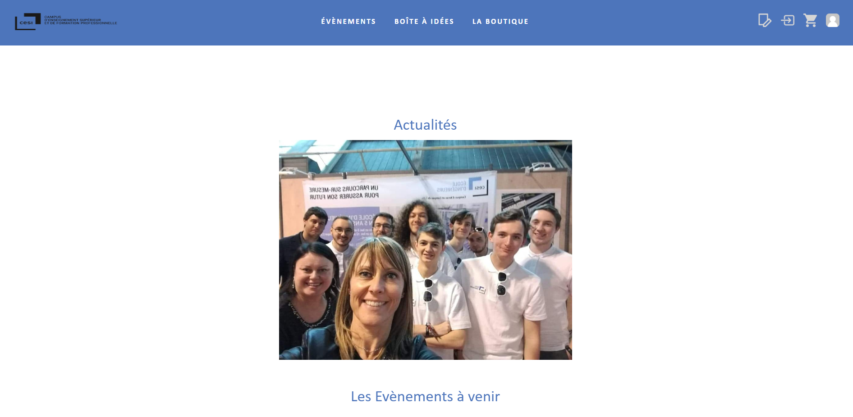
Presentation of the website | Host

Slide 8
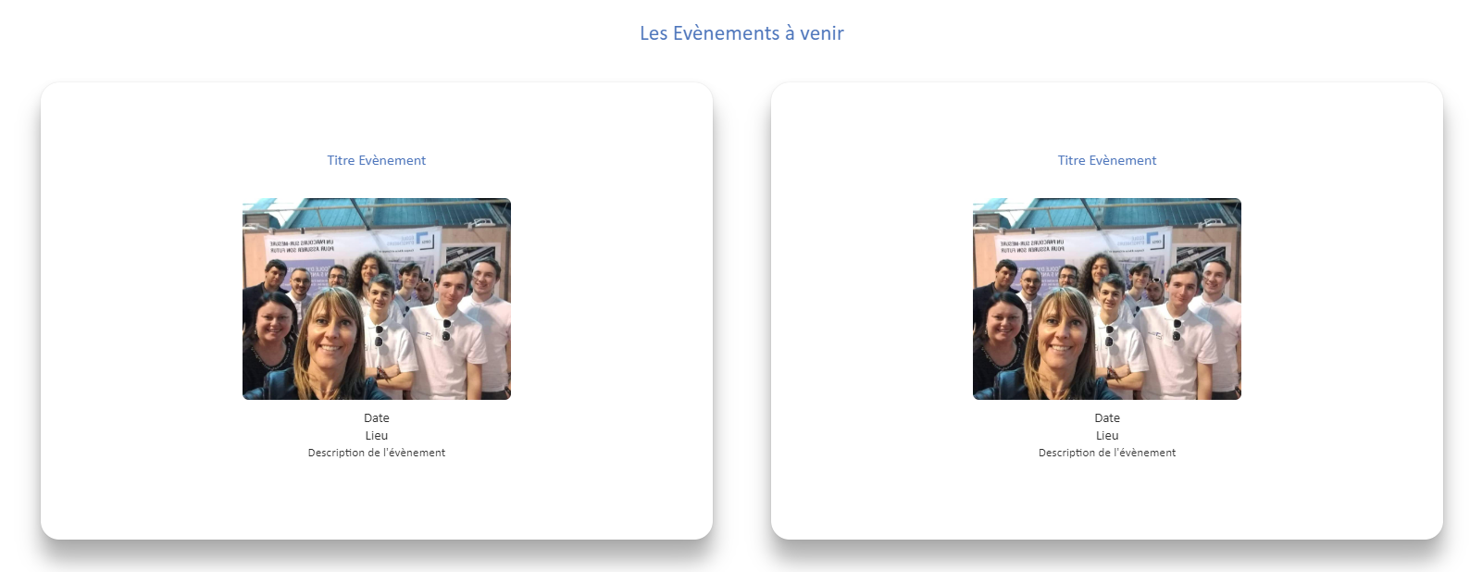
Presentation of the website | Host

Slide 9
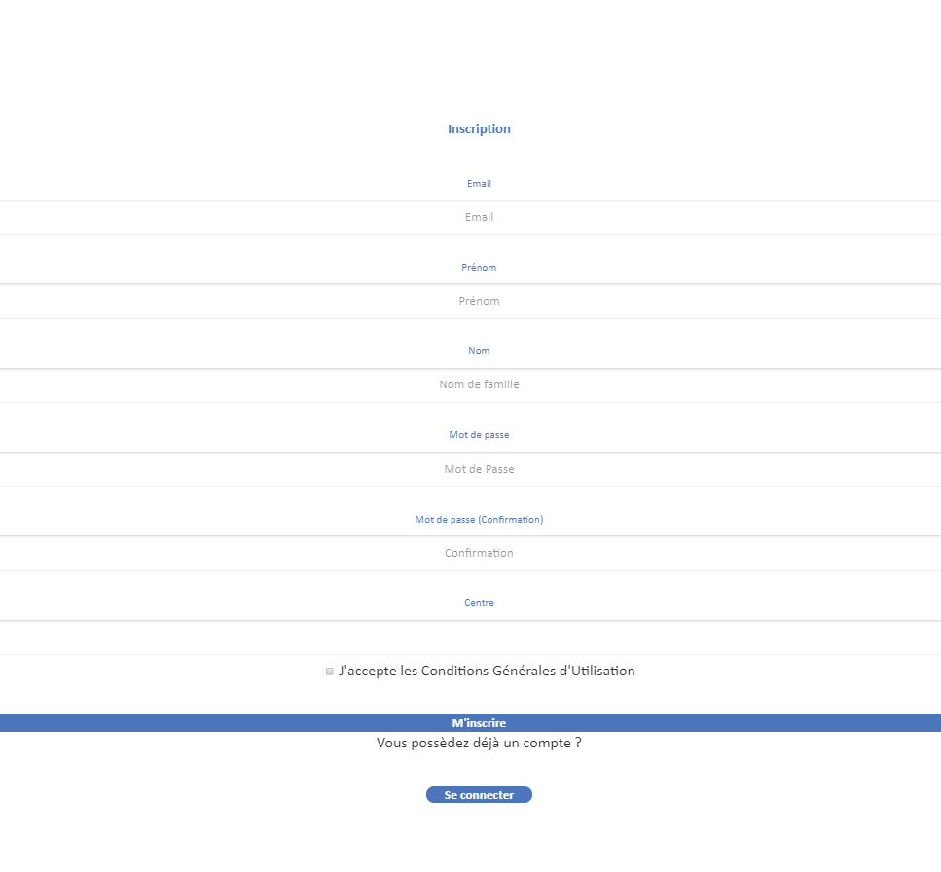
Presentation of the website | Host

Slide 10
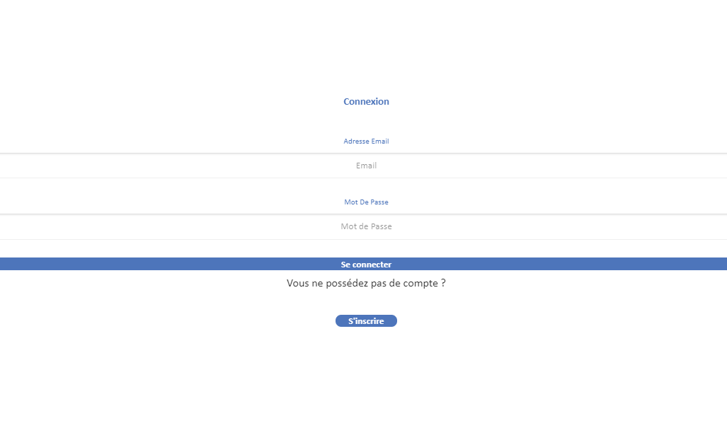
Presentation of the website | Host

Slide 11
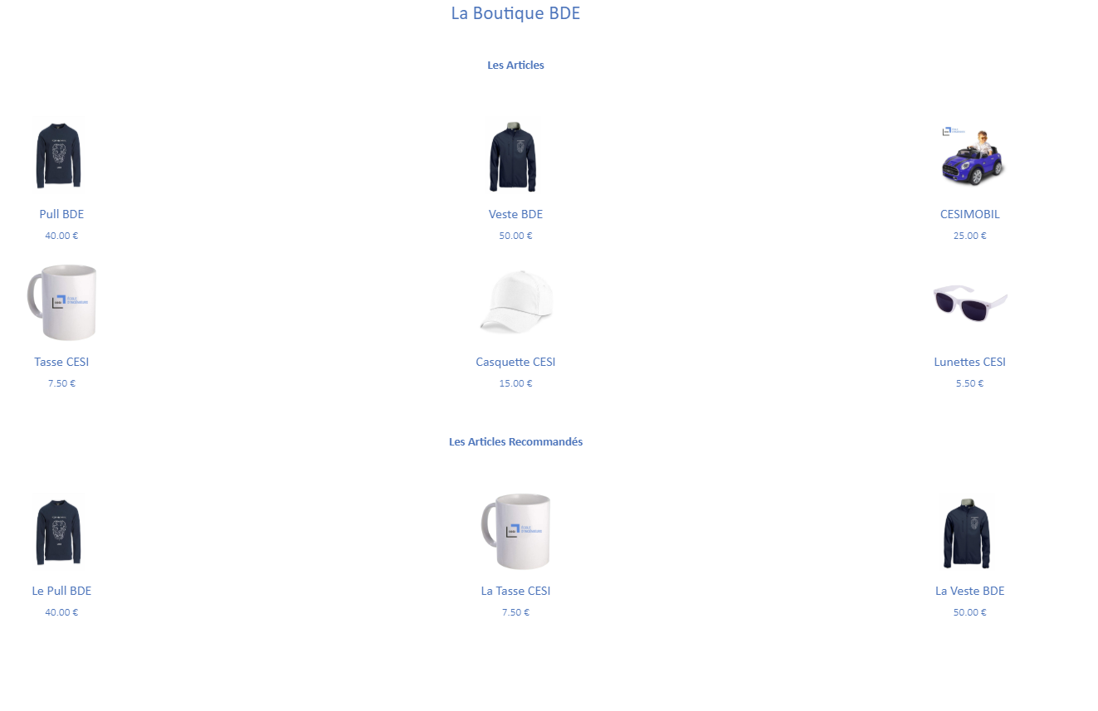
Presentation of the website | Events

Slide 12
Presentation of the website | Ideabox

Slide 13
Presentation of the website | Shop

Slide 14
Presentation of the website | Legal notice

Slide 15
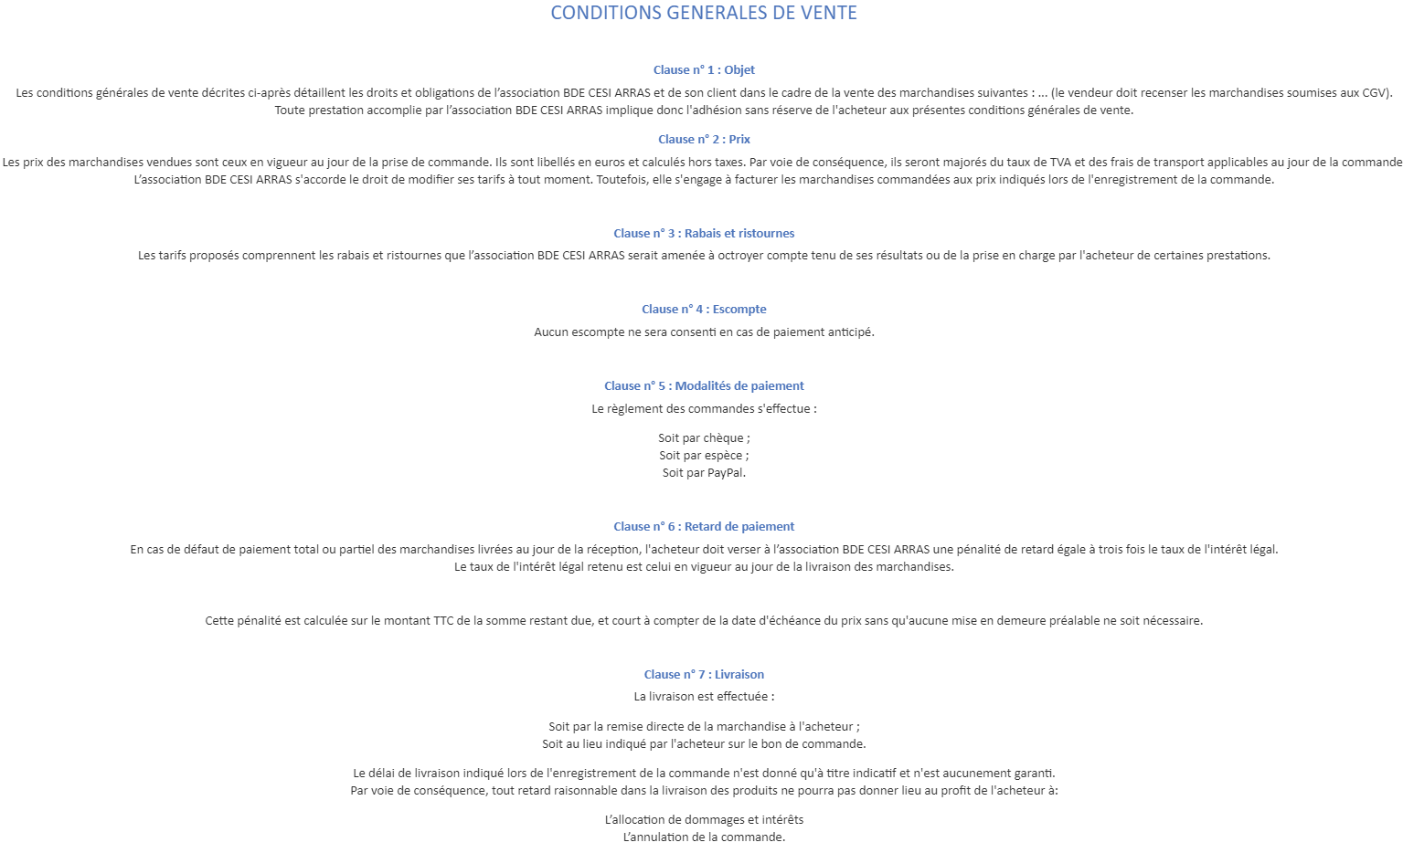
Presentation of the website | Terms and conditions

Slide 16
Presentation of the website | Terms

Slide 17
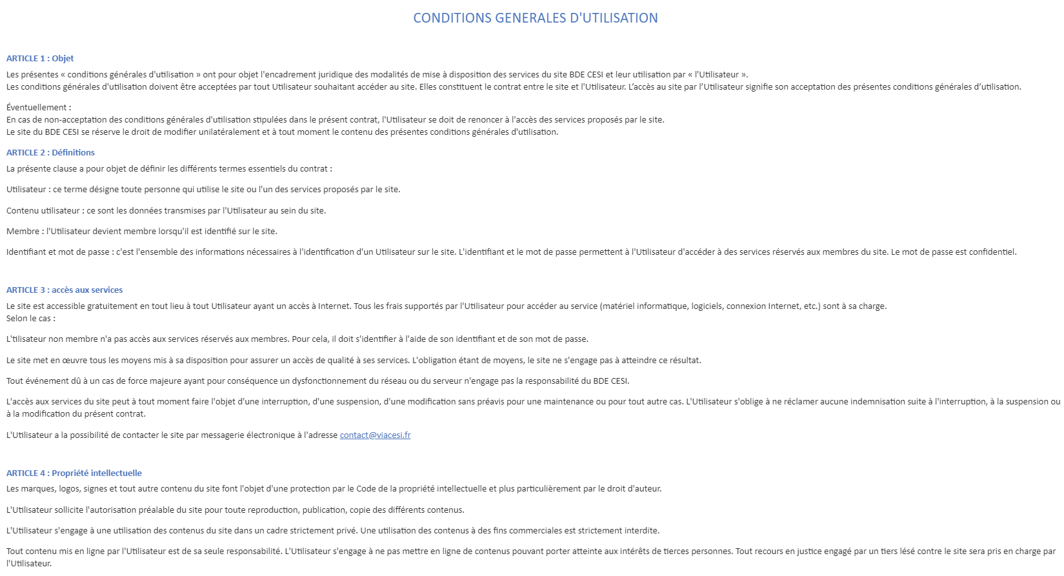
Presentation of the website | Terms of service

Slide 18
Improvement points

Slide 19
Conclusion
A
A
A

